Slide 2
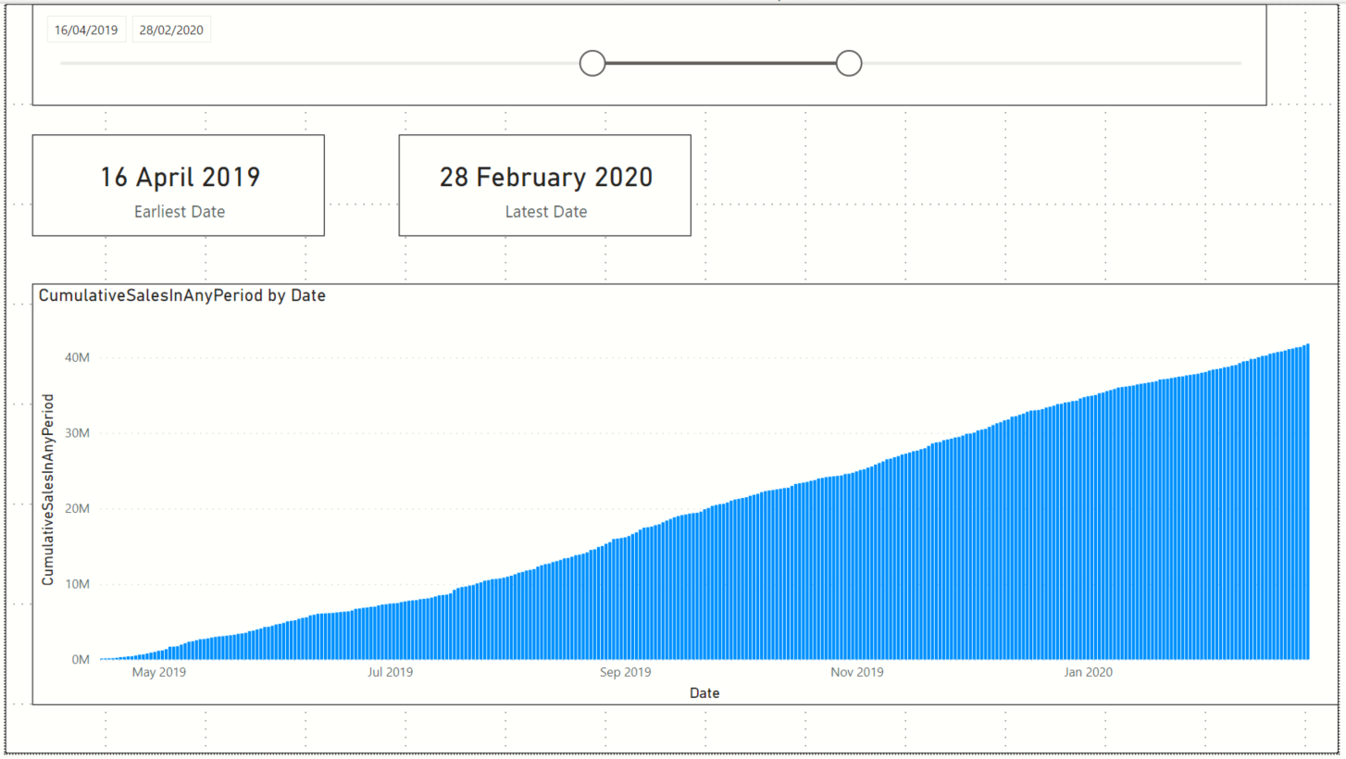
Card showing earliest
MyCalendar[Date]
Slicer on MyCalendar[Date]
Card showing latest
MyCalendar[Date]
Stacked Column Chart visual
X-axis = MyCalendar[Date]
Values = Custom measure CumulativeSalesInAnyPeriod

Slide 3
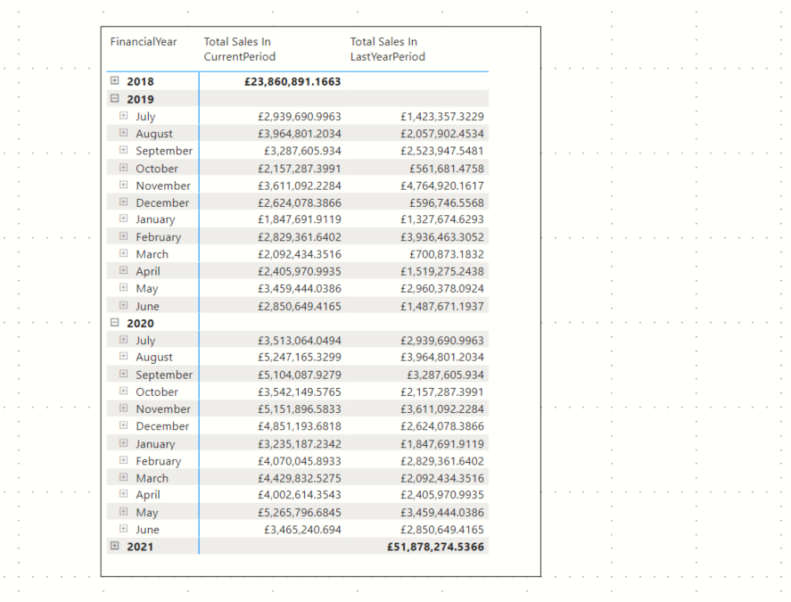
Custom measure TotalSalesInPeriodUsingMyCalendar
Visual hierarchy using the
Financial Year
Financial Month
Day
columns of the MyCalendar[Date]
Custom measure TotalSalesInLastYearPeriodUsingMyCalendar
How do we know this DAX measure works?
The sales for a period in 2020 matches the previous years sales

Slide 4
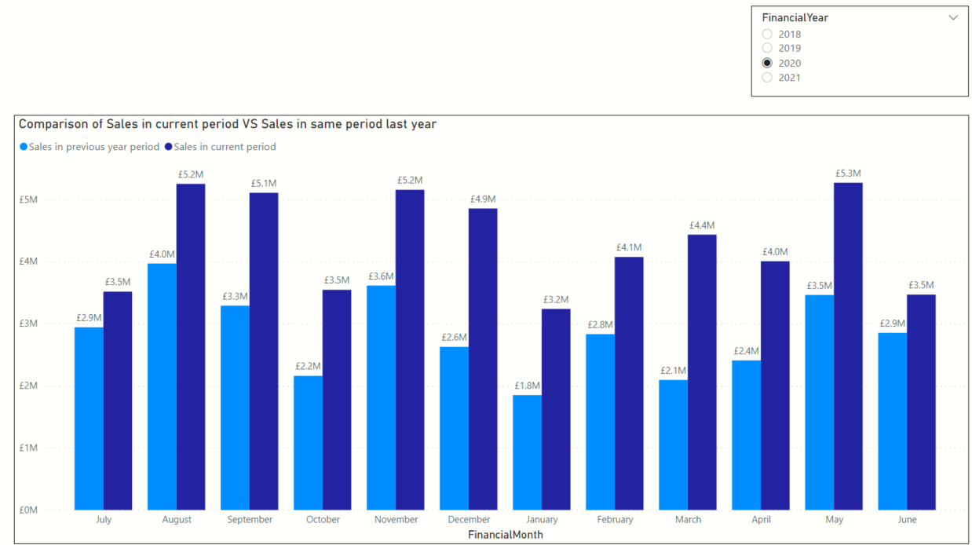
Clustered column chart
X-axis => Financial Month column of MyCalendar
Values => Custom measures
TotalSalesInPeriodUsingMyCalendar
TotalSalesInLastYearPeriodUsingMyCalendar
Slicer
Financial Year column of MyCalendar
Measure TotalSalesInLastYearPeriodUsingMyCalendar
Measure TotalSalesInPeriodUsingMyCalendar

Slide 5
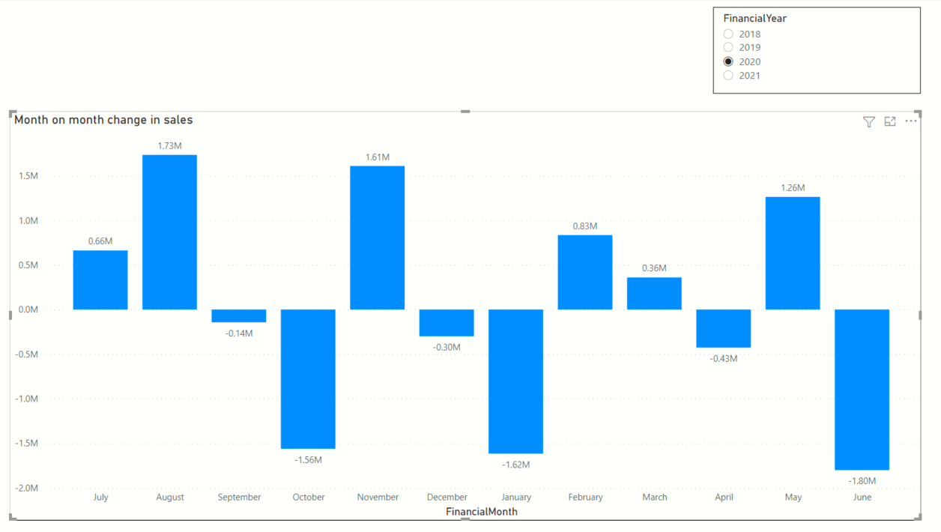
Clustered column chart
X-axis => Financial Month column of MyCalendar
Values => Custom measure MonthOnMonthChangeInSales
Slicer
Financial Year column of MyCalendar
A drop in monthly sales from Dec to January

Slide 6
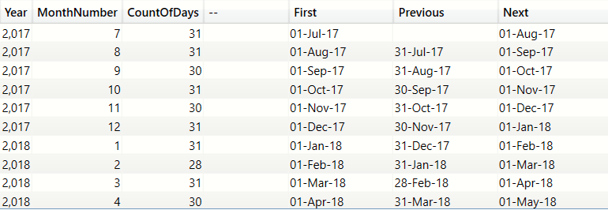
PREVIOUSDAY()
NEXTDAY()
First day in the month
We are in November
First date in current context=Nov 1st
Last date in current context=Nov 30th
PREVIOUSDAY=1 day prior to the first date = 31st Oct
NEXTDAY =1 day after the last date =1st Dec

Slide 7
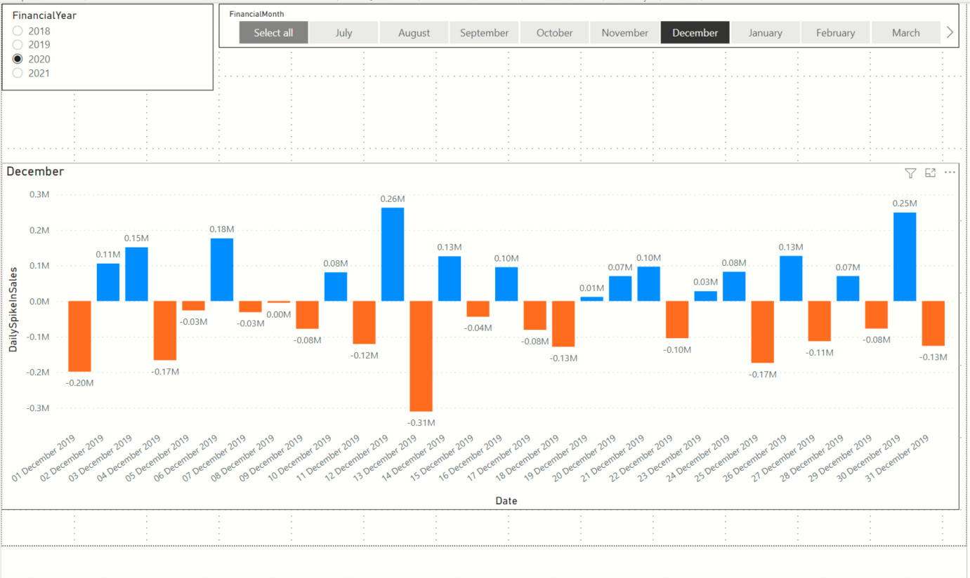
Slicer on MyCalendar[FinancialYear]
Slicer on MyCalendar[FinancialMonth]
Clustered column chart visual
Axis = MyCalendar[Date]
Values = Custom measure ‘DailySpikeInSales’

Slide 8
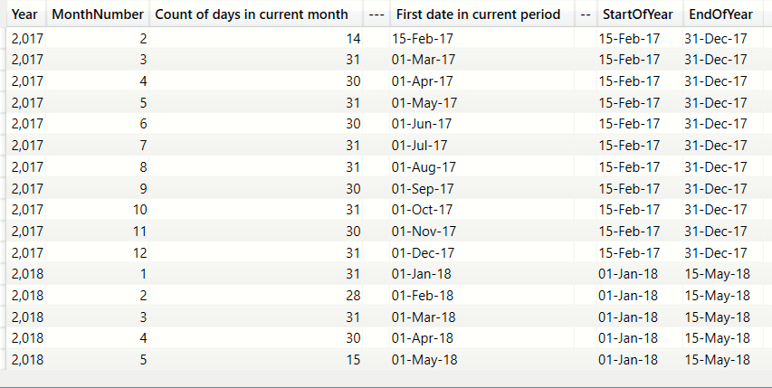
Grouping by Year and Month in descending order
Current context is set to April 2017
STARTOFYEAR= 15-Feb-2017 (the earliest date is 15-Feb-2017, the first available date in the Table)
ENDOFYEAR= 31-Dec-2017
Current context is set to Mar 2018
STARTOFYEAR= 1-Jan-2018 (the first available date in 2018)
ENDOFYEAR =15-May-2017 (last available date in the Date table)

Slide 9
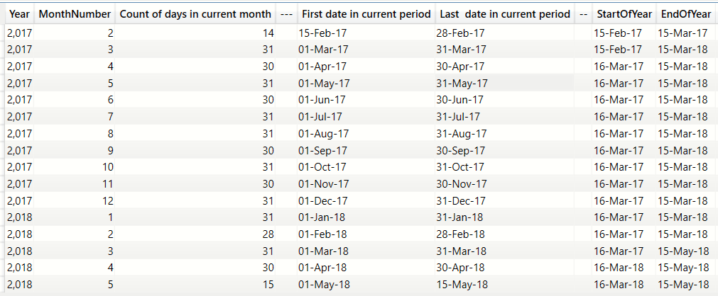
Grouping by Year and Month in descending order
Current context =Feb 2017
Last date in ctx=28 Feb 2017 < 15 Mar 2017
ENDOFYEAR=15-Mar-2017
Current context =Mar 2017
Last date in ctx=31 Mar 2017 > 15 Mar 2017
ENDOFYEAR=15-Mar-2018
Current context =Jan 2018
First date in ctx= 1 Jan 2018 > 15 Mar 2017
STARTOFYEAR=16 Mar 2017
Last date in ctx=31 Jan 2018 < 15 Mar 2018
ENDOFYEAR=15-Mar-2018

Slide 10
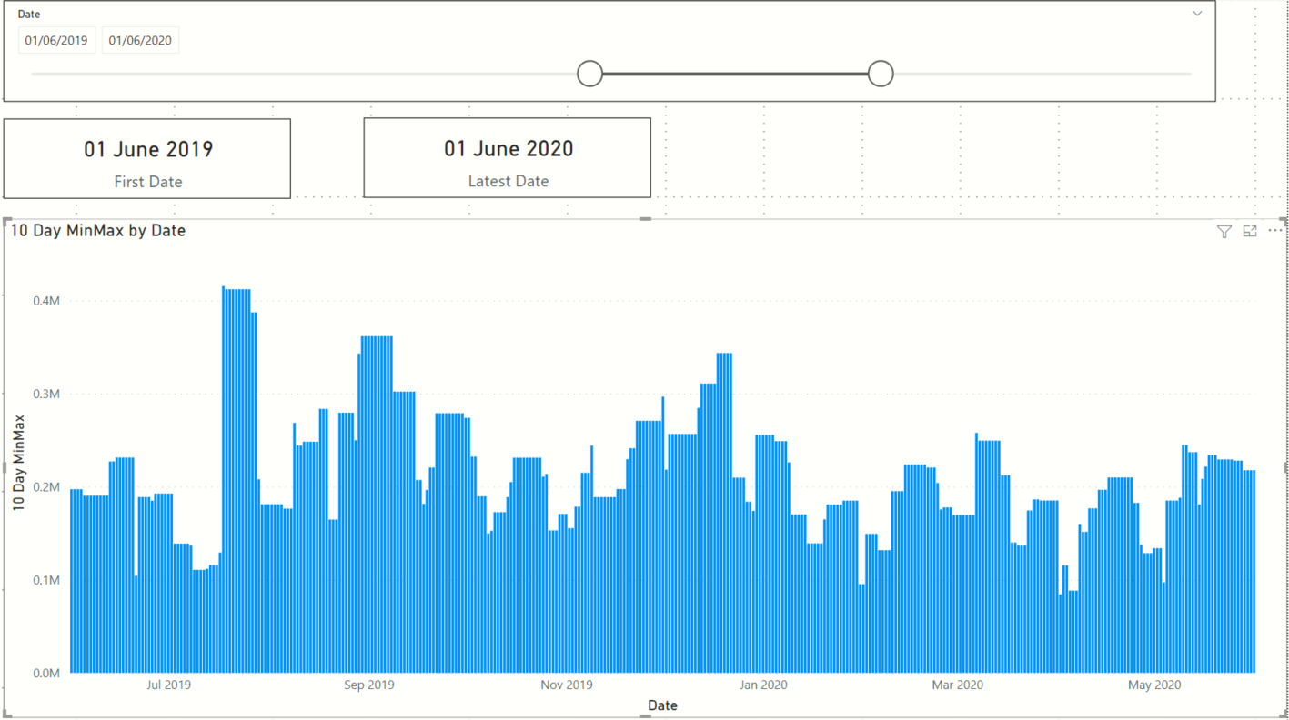
Slicer on MyCalendar[Date]
Clustered Column Chart
Values=[Custom measure 10 Day Min Max]
Each bar represents the MAX-MIN of the daily sales in the last 10 days
Axis=MyCalendar[Date]

Slide 11
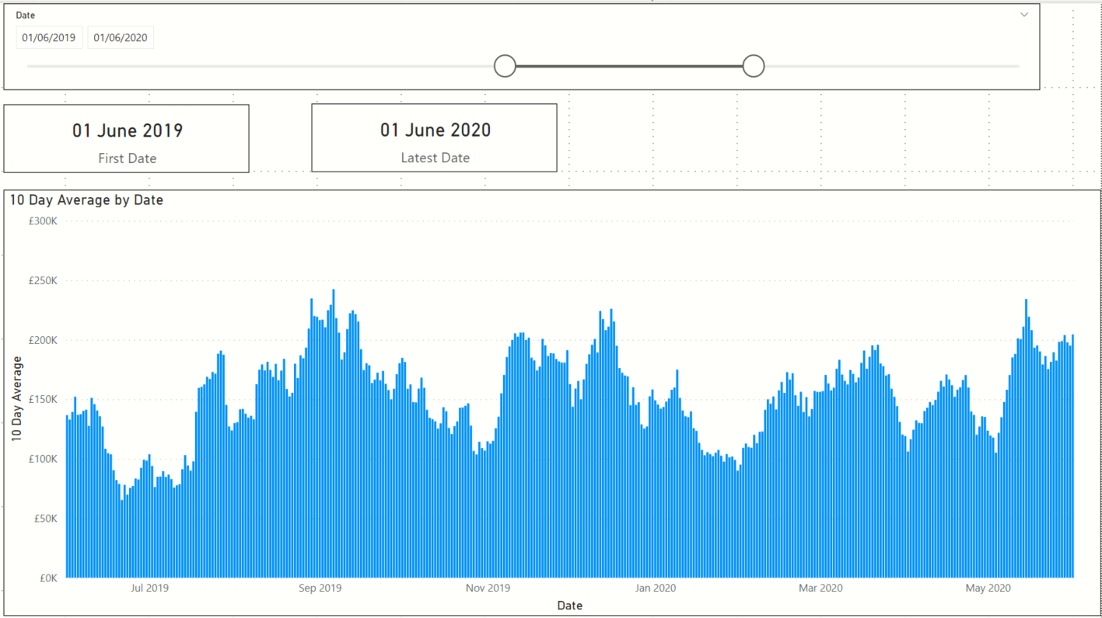
Slicer on MyCalendar[Date]
Values=[Custom measure 10 Day Average]
Clustered Column Chart
Each bar represents AVERAGE of the daily sales in the last 10 days
Axis=MyCalendar[Date]

Slide 12
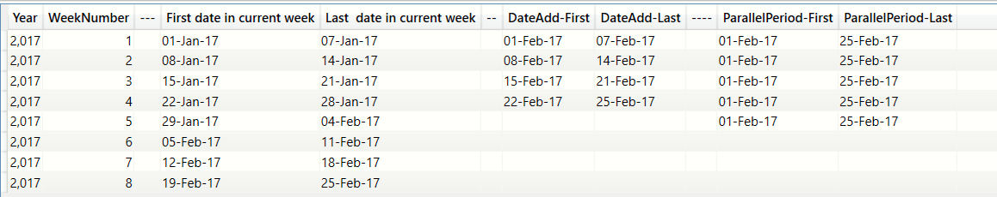
Group by Year and WeekNumber
FIRSTDATE and LASTDATE on DATEADD(+1 month)
FIRSTDATE and LASTDATE on PARALLELPERIOD(+1 month)
The outcome of DATEADD is restricted to the Week start and end (15 to 21 Feb)
The outcome of PARALLELPERIOD stretches to all the dates available in that month (1 to 25 Feb)

Slide 13
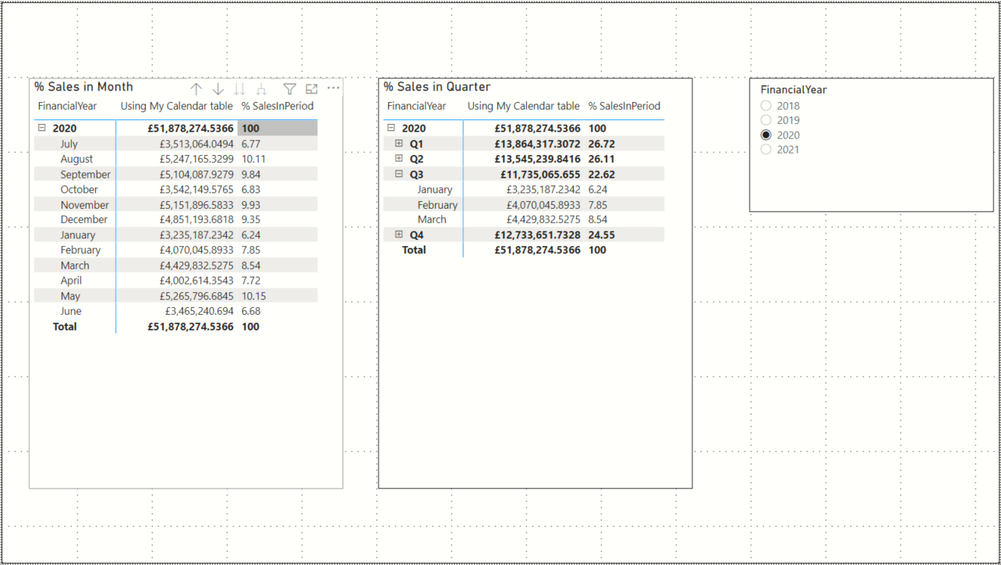
Custom measure % OfAnnualSalesInPeriod
Visual hierarchy using the
Financial Year
Financial Quarter
Financial Month
columns of the MyCalendar table
Slicer on Financial Year column of of the MyCalendar table
Visual hierarchy using the
Financial Year
Financial Month
columns of the MyCalendar table

Slide 14
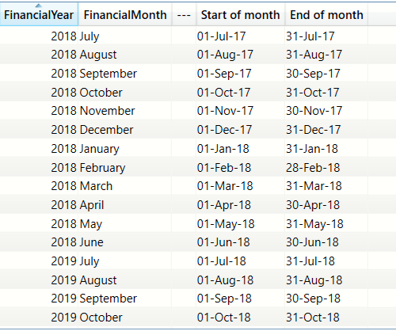
The financial year starts on July 1st
STARTOFMONTH => 1 Aug
ENDOFMONTH=> 31 Aug

Slide 15
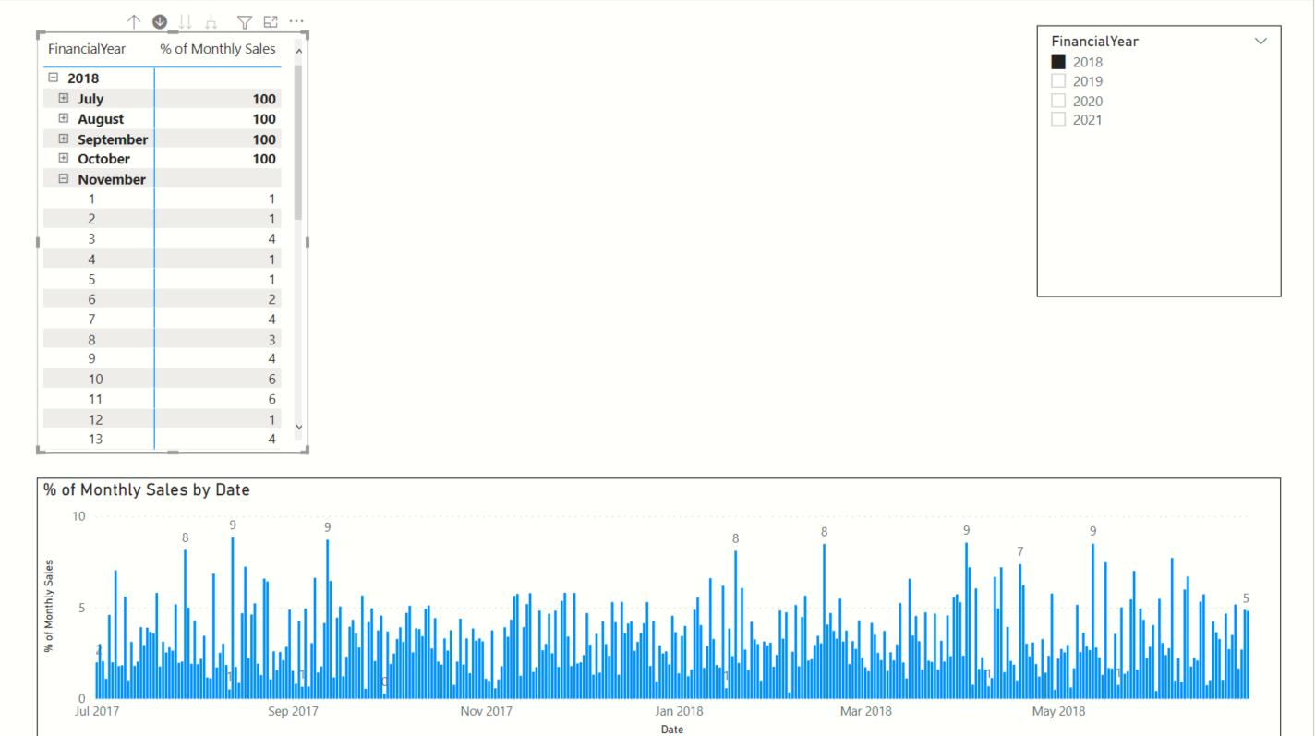
Visual hierarchy using the
Financial Year
Financial Month
columns of the MyCalendar table
Custom measure % OfAnnualSalesInPeriod
Slicer on Financial Year column of of the MyCalendar table
Axis=MyCalendar[FinancialMonth]

Slide 16
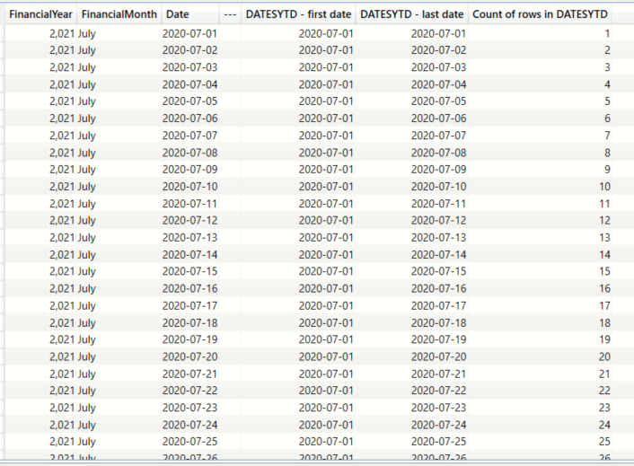
DATESYTD will produce a sequentially incrementing table of dates
The first date produced by DATESYTD remains fixed to “year end” + 1

